Slide 1
Principles and Parameters: Acquisition issues.
Prezentation by:M. Musilová
O.Chudada
L. Brychová

Slide 2
Background
Principles and parameters is a linguistic theory largely formulated by the linguists Noam Chomsky and Howard Lasnik, though it was the culmination of the research of many linguists.
Today, many linguists have adopted this framework, and it is considered the dominant form of mainstream generative linguistics.

Slide 3
What are the Principles and Parameters in syntax?
An approach to the question of how children acquire language.
Ideas started shaping since the early days of modern generative grammar.
Syntax is described with the use of:
  A) general principles
    Abstract rules
    Grammar
  B) specific parameters
    Markers
    Switches

Slide 4
Previous ideas and observations
Despite large variations, languages have many common properties on an abstract level.
  Parts of language that are not present in the physical world.
Children learn languages easily, despite the fact that language are often complex.
Idea: the common properties of languages are present, only variations need to be learned.

Slide 5
Principles and Parameters
Universal Grammar can be deﬁned as:
The set of Principles that are common to all languages.
  The initial state of language knowledge for human beings.
Principles may include parameters, which represent settings that may vary from language to language.
Children ’simply’ need to learn the values of relevant parameters to acquire the grammar of their native language

Slide 6
Goals of syntactic research
The research on syntax should answer the following questions:
  What are the Principles that are part of Universal Grammar?
  What parameters are there in Universal Grammar, and what are their possible values in individual languages?
Within this framework, the goal of linguistics is to identify all of the principles and parameters that are universal to human language (Universal Grammar).

Slide 7
Framework
The central idea of principles and parameters is that a person's syntactic knowledge can be modeled with two formal mechanisms:
  A finite set of fundamental principles that are common to all languages.
    Example: A sentence must always have a subject, even if it is not overtly pronounced.

Slide 8
Framework
A finite set of parameters that determine syntactic variability amongst languages.
  binary parameter that determines whether or not the subject of a sentence must be overtly pronounced (this example is sometimes referred to as the Pro-drop parameter).
    Example: [I (am)] going to the store.

Slide 9
Framework
Any attempt to explain the syntax of a particular language using a principle or parameter has to be cross-examined with the evidence available in other languages.
  Part of Comperative linquistics. Finding similarities and common elements in languages.

Slide 10
Principles within the structure
There are several principles present in the UG acording to the Principles and parameters theory:
  Structure Preservation Principle:
    Deep Structures should be preserved by a movement transformation, which simply rephrases the sentence.
  Projection Principle:
    The range of syntactic elements with which a lexical unit combines can be ‘projected from’ a lexicon as restrictions on structures that contain it.

Slide 11
Structure Preservation Principle
The Structure Preservation Principle is a stipulation proposed by Noam Chomsky as part of the Generative-Transformational Grammar.
Under the Structure Preservation Principle, Deep Structures should be preserved by a movement transformation, which simply rephrases the sentence.
  Example of this Principle:
  Fabio strangled Prince Jamal. Can be transformed into:
  Prince Jamal was strangled by Fabio. and this Principle is fulfilled.
Both sentences hold the same meaning, because their Deep Structure remains equal. Only their Surface Structure changes, this is, just the arrangement of the words changes. Of course, auxiliary words like by are needed for the rearrangement to work.

Slide 12
Projection Principle
The projection principle is used in the derivation of phrases.
  Under the Projection Principle, the properties of lexical items must be preserved while generating the phrase structure of a sentence.
The Principle, as formulated by Chomsky, states that "lexical structure must be represented categorically at every syntactic level" (Chomsky 1986: 84).

Slide 13
Projection Principle
Chomsky further defined the projection principle as "representations at each level of syntax are projected from the lexicon in that they observe the sub-categorisation properties of lexical items."
  For example, the verb strangle, apart from the subject, has an obligatory argument, its object, which must appear in the sentence.

Slide 14
Projection principle
The following sub-categorization frame for the verb strangle specifies its properties; the underlined gap for the location of the verb is followed by the noun phrase (NP):
  Strangle- Verb, [NP]It is out of this frame that a sentence like the following can be generated:
  Fabio strangled Prince Jamal.
A sentence without the object, in violation of the verb's sub-categorization frame and the Projection Principle, would be ill-formed:*Fabio strangled.

Slide 15
  Specific parameters
A finite set of parameters that determine syntactic variability amongst languages;
English is considered a non-pro-drop language. Nonetheless, subject pronouns are almost always dropped in imperative sentences (e.g., Come here).

Slide 16
Specific parameters
In informal speech, pronouns may sometimes be dropped in other type of sentences, together with some other words, especially copulas and auxiliaries:
  [Have you] ever been there?
  [I'm] going to the shops. [[Do] you] want to come [with [me]]?

Slide 17
Examples
Head-directionality parameter
Nominal mapping parameter
Null subject parameter
Polysynthesis parameter
Serial verb parameter
Topic prominent parameter
Verb attraction parameter

Slide 18
Head-directionality parameter
In linguistics, the head directionality parameter is a proposed parameter that classifies word order according to the placement of heads in phrases.
Head directionality is also understood in terms of the direction of branching.

Slide 19
Head-directionality parameter
One distinguishes between two major types of phrases:
  Head-initial (= right-branching) phrases: Heads precede their dependents.
    English (head-initial): John has put the book on the table.
  Head-final (= left-branching) phrases: Heads follow their dependents.
    German (head-final): Jan hat das Buch auf den Tisch gelegt, [John-has the-book on-the-table put].

Slide 20
Pro-drop parameter
(from "pronoun-dropping") is a language in which certain classes of pronouns may be omitted when they are in some sense pragmatically inferable.
Can be common in some languages (Japanise, Slavic languages).
Or are part of the spoken part of language. (English)
  [Have you] ever been there?
  [I'm] going to the shops. [[Do] you] want to come [with [me]]?

Slide 21
Language acquisition
According to this framework, principles and parameters are part of a genetically innate universal grammar (UG) which all humans possess.
As such, principles and parameters do not need to be learned by exposure to language. Rather, exposure to language merely triggers the parameters to adopt the correct setting.

Slide 22
Acquisition issues
The first issues is the complexity of languages, yet children seen to aquire it almost effortlessly..
Languages differ, in pronunciation, word order, grammar.
  Universals: language is universally acquired in the same manner and the deepest structure is the same in all languages.
    Principles: are universal:Word order, Question, Formation, Agreement
    Parameters : vary across languages

Slide 23
Rules
By specifying sentences into structural patterns, linguistics believe it is possible to identify the general rules in which languages are aquired and used.
Two different typer of rules exist in this theory:
  Phrase structure rules.
  Relational dependenci rules.

Slide 24
Phrase structure rules
A phrase is a syntactic unit headed by a lexical category such as Noun, Adjective, Adverb, Verb, or Preposition.
  •
  Phrases are named for their heads:
  • NP, VP, AdjP, AdvP, PP
How phrases are formed is governed by rules (= ‘phrase structure rules´)

Slide 25
Phrase structure rules
Rules that determine:
  what goes into a phrase (‘constituents’)
  how the constituents are ordered
Constituent is a word or group of words:
  that function as a unit and can make up larger grammatical units
  Phrase and head
Each rule “rewrites” a constituent into one or more constituents

Slide 26
Phrase structure rules
are generative, allow recursion.
give different analyses of syntactically ambiguous sentences.
have a hierarchical structure.

Slide 27
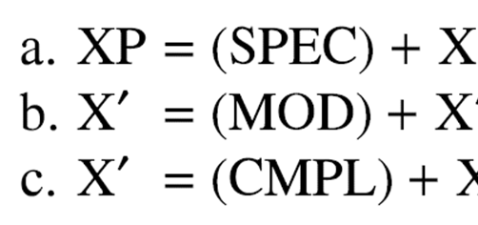
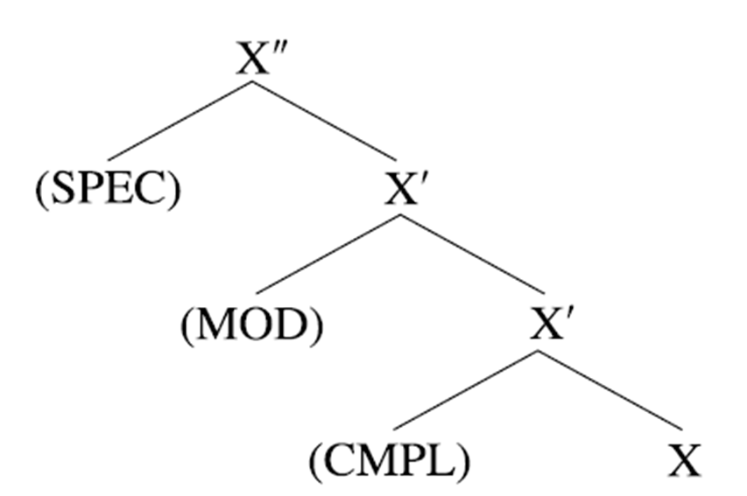
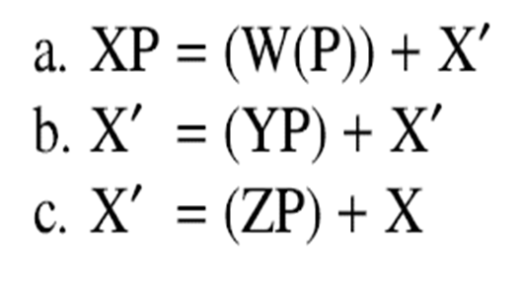
  Phrase structure rules.
General x-bar schema for phrase structure:

Slide 28
Phrase structure rules
Examples – structure of the English noun phrase(NP)
NP → (Det) (Adj) N (PP)
the unopened books on the table
So NP must contain a NP but can also contain a lot of other phrases.

Slide 29
Phrase structure rules
Examples- structure of the verbal phrase (VP)
  VP → V talked
  VP → V Adv talked loudly
  VP → V NP ate their desserts
  VP → V NP PP (Adv) put the book on the table (wearily)
  VP → V (S) know (the students attended their lectures)
So, a VP must contain a verb, but can also contain a lot of other phrases (...): VP → V (NP) (PP)(Adv) (S)

Slide 30
Phrase structure rules
Sentence/Clause-level PS Rules (English has quite a fixed clause-level PS Rule)
  1. S → NP VP (a sentence is obligatorily comprised of a NP and a VP)
  [NP The students] [VP attended their lectures]
  2. S → NP (Aux) VP
The students will take exams.
Sentence must contain NP and VP, the auxiliary is optional, we can indicate this with (...).

Slide 31
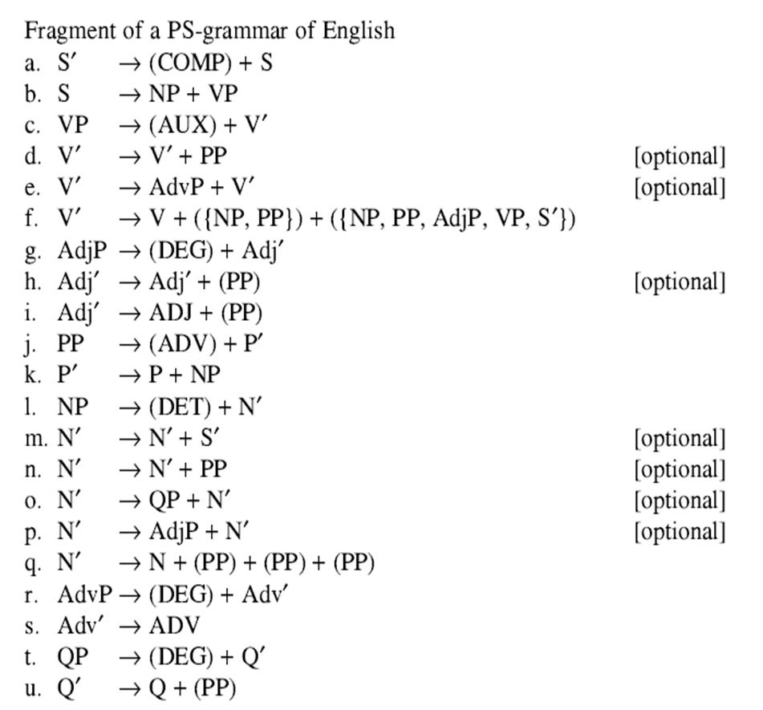
Phrase structure rules

Slide 32
Phrase structure rules;
Ambiguous sentences
Heads and dependants(=other elements of the phrase) form phrases, sentences can be syntactically correct but semantically wrong
e. g. - Mary saw the man with the telescope
Two meanings – Mary used a telescope for seeing a man. or Mary saw a man holding a telescope.
→ ambiguous

Slide 33
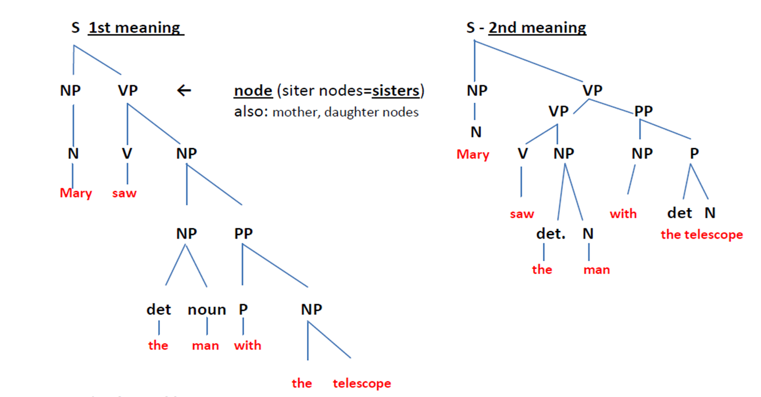
Phrase structure rules

Slide 34
Phrase structure rules
Recursion
Language is infinite – you can say sentences that have never been said before
a)NP N PP
b)PP P NP
NP
N PP
P NP
N PP etc.. (applying the same rule)

Slide 35
  The lexicon and sub-categorization
The frog died
The frog died the cat
The frog died the cat to the mouse
The V´in (a) is that of an intransitive verb, and accordingly intransitive verbs like die and dissappear should occur in it but transitive and other verbs should not

Slide 36
The lexicon and sub-categorization
The cat devoured.
The cat devoured the mouse.
The cat devoured themouse the frog
Transitive verb (b)

Slide 37
The lexicon and sub-categorization
The boy put.
The boy put the magazine.
The boy put the magazine on the table
Transitive verb with PP in V´ (c)

Slide 38
How would such a principle be realized formally in the kind of grammar?
1. step is categorizing verbs as intransitive, transitive, etc.
This inormation is represented in the lexical entry for each verb in the lexicon
The lexical entry for a lexical item like verb contains phonological, semantic and syntactic information about it
e.g. the English verb talk, the form in the lexical entry -> talk

Slide 39
The lexicon and sub-categorization
The semantic information includes its argument structure
  e.g. <Patient> for die or
  <Agent Theme recipient> for donate

Slide 40
Subcategorization frame
a. die [v´_]
b. devour [v´_NP]
c. Put [v´_NP PP]
The ´_´ indicates the possition occupied by the verb
Die occurs in a V´ without any sister NPs - > intransitive verb

Slide 41
Syntactic subcategorization frame
If an argument is represented in the semantic argument atructure of the verb and it would not bethe subject, then it must be in the verb´s syntactic subcategorization frame.
a. die [v´_]
          <Patient>
b. devour [v´_NP]
          <Agent Patient>
c. put [v´_NP PP]
          <Agent Theme Location>

Slide 42
Conclusion
In this prezentation we tried to explain what the principles and paraments of language acquisition are, as well as the issues that arise in explaining their presence in language learning.

Slide 43
References
Chomsky, N. (1981). Lectures on Government and Binding. Mouton de Gruyter.
Chomsky, N. and Lasnik, H. (1993) Principles and Parameters Theory, in Syntax: An International Handbook of Contemporary Research, Berlin: de Gruyter.

